Slide 1




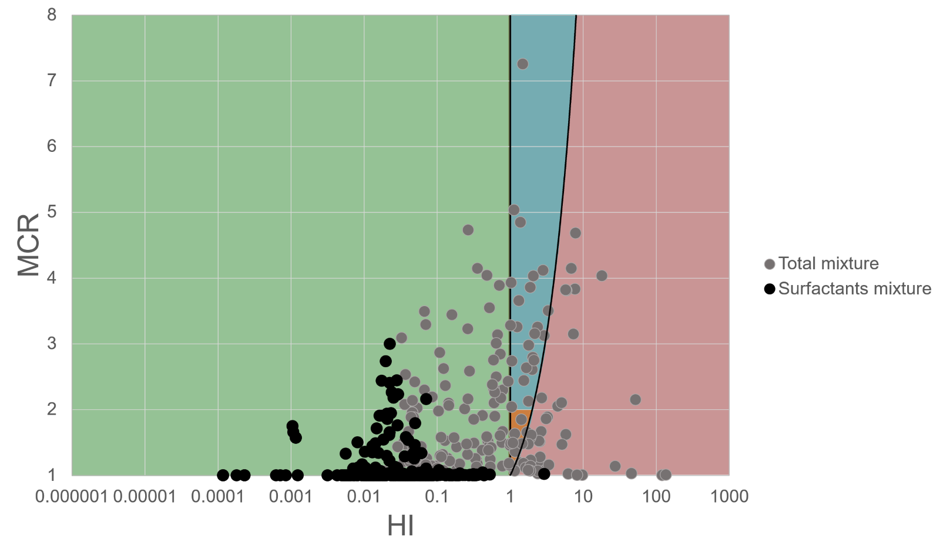
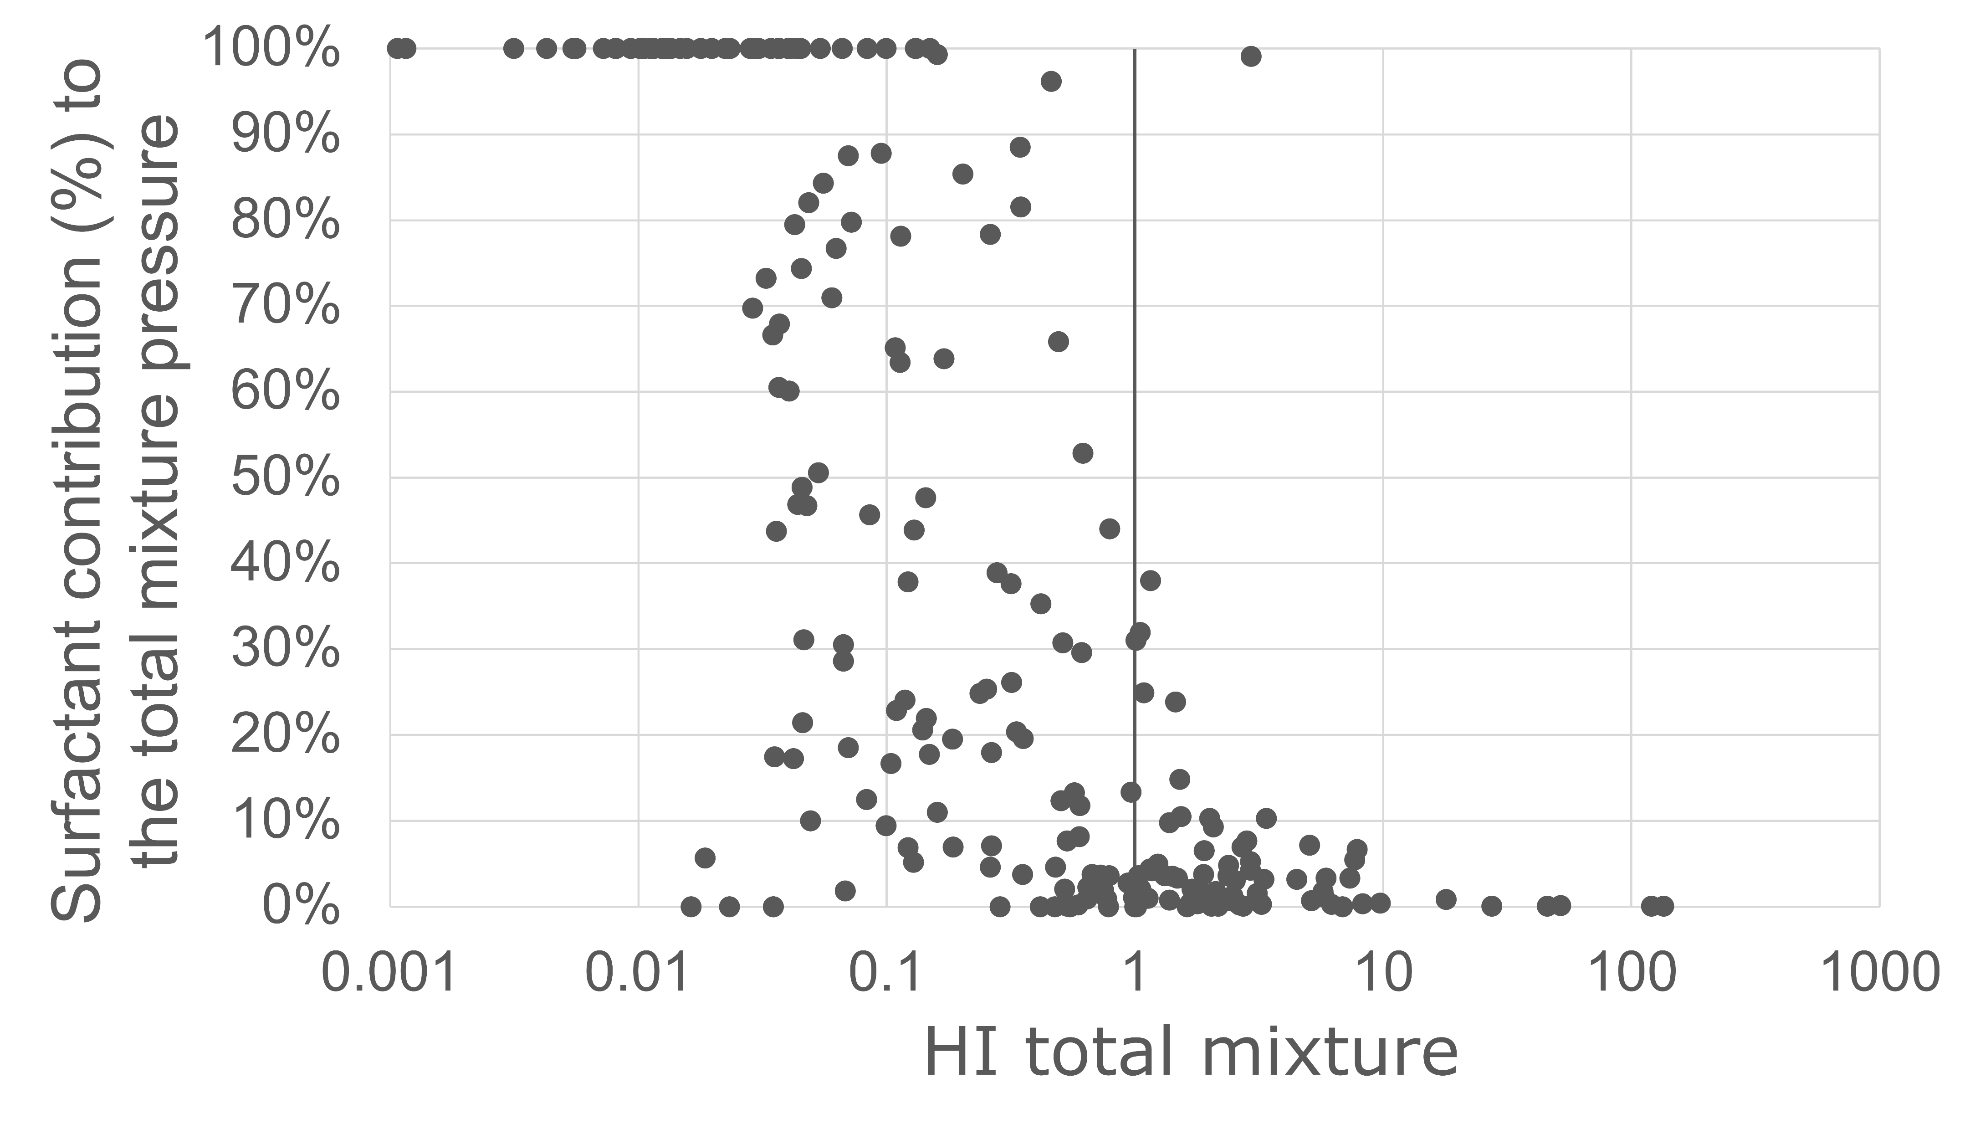
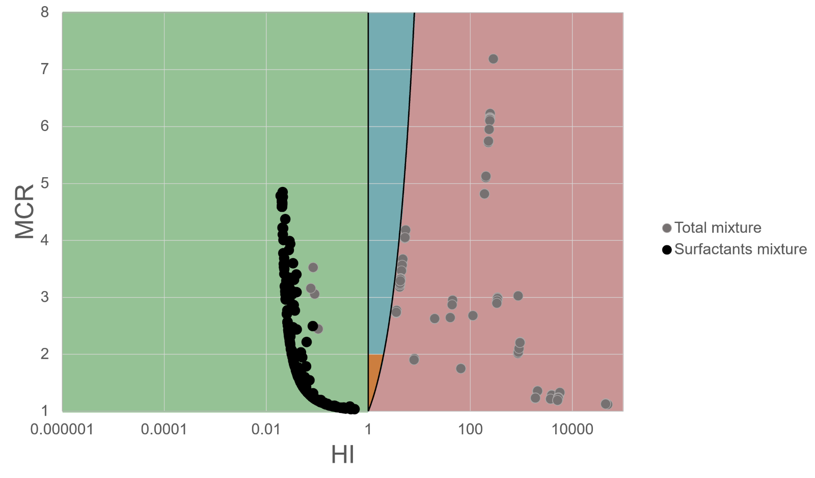
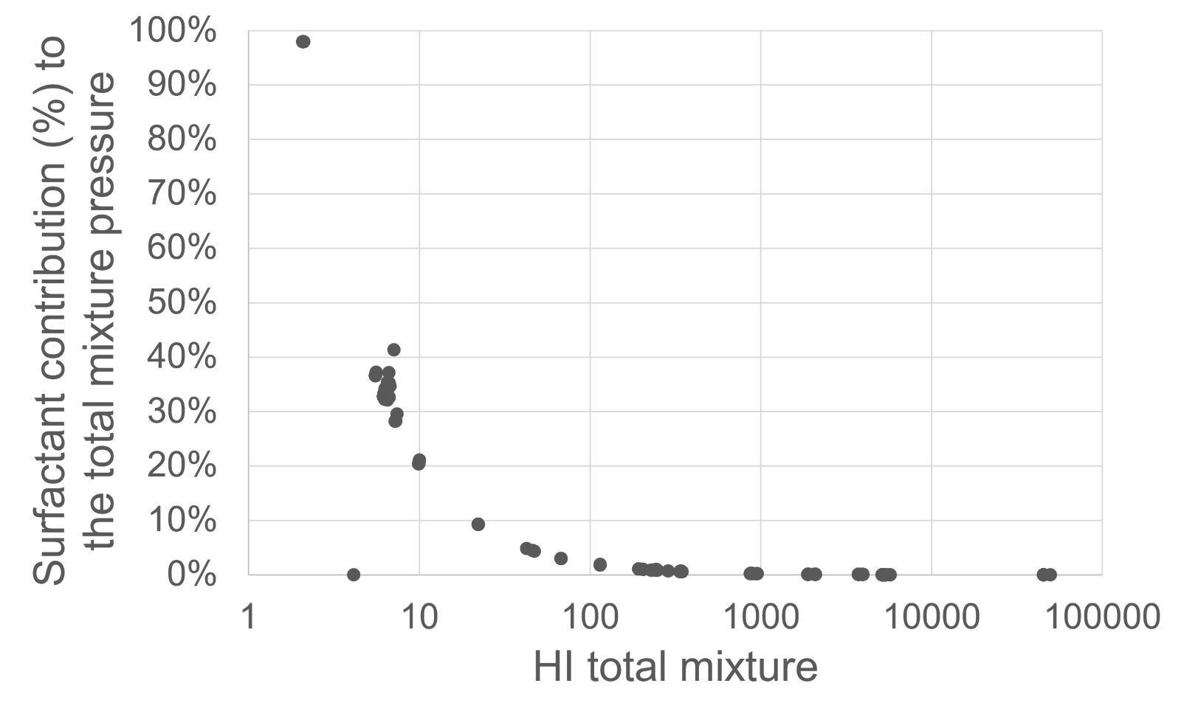
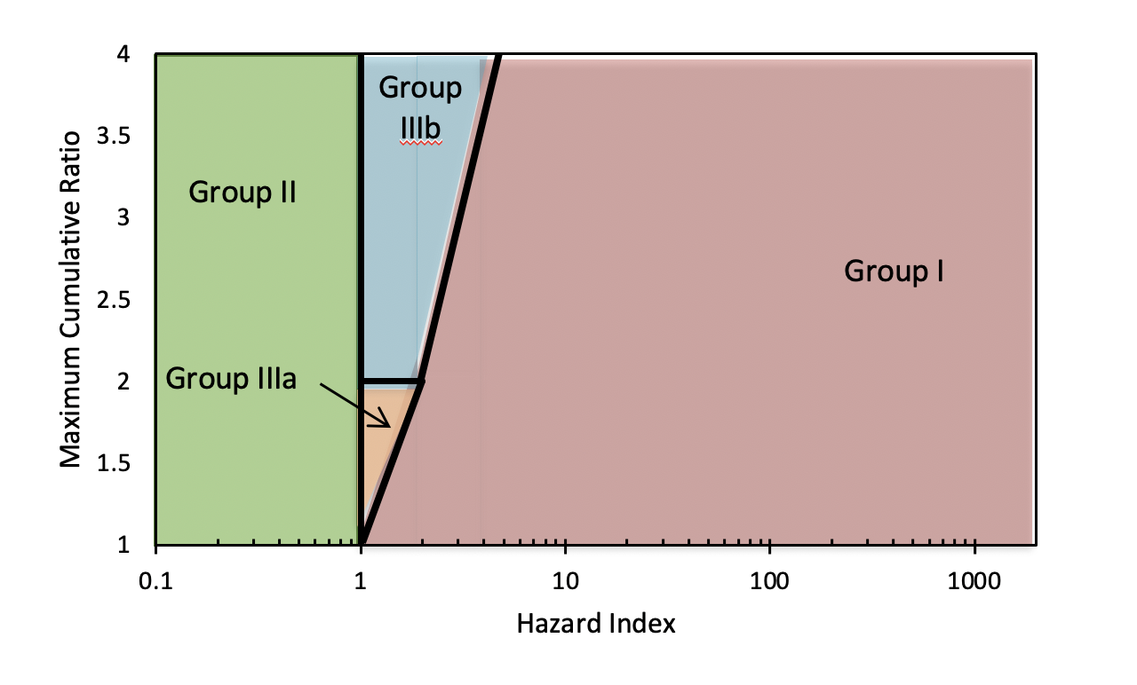


Assessment of the contribution of surfactants to mixture toxicity in French surface waters
Nathalie Briels¹, Charlotte Nys¹, Karel Viaene¹, Frederik Verdonck¹, Erin M. Maloney²*, James Dawick³, Chiara Maria Vitale⁴, Diederik Schowanek⁴
¹ ARCHE Consulting, Liefkensstraat 35D, 9032 Gent, BE
² Shell Global Solutions, Carel van Bylandtlaan 16, 2563 HR, Den Haag, NL
³ Innospec, Innospec Manufacturing Park Oil Sites Road Ellesmere Port CH65 4EY, UK
⁴ Procter and Gamble, Brussels Innovation Centre, Temselaan 100, 1853 Strombeek-Bever, BE * Presenting author: erin.e.maloney@shell.com
_____________________________________________ Environmental Risk Assessment and Management A research partnership of the Detergents and Surfactants Industries in Europe
Background
Surfactants are high production volume chemicals, largely used in industrial applications, household cleaning substances, and other personal care products.
Consumer use of surfactants largely results in ‘down-the-drain’ disposal, resulting in environmental exposure through residual discharge from wastewater treatment plants¹ and detection of surfactants in complex mixtures. This necessitates consideration of their relative contribution to cumulative toxicity under field-realistic exposure scenarios.
Recent datasets are available from INERIS² and EauFrance³ providing publicly accessible and comprehensive environmental monitoring reports from surface waters in France. These represent ideal datasets to use for a retrospective analysis of mixture toxicity in representative European surface waters.
Given the upcoming introduction of the Mixture Assessment Factor (MAF) under EU REACH, it is important to characterize the relative contribution of widely detected substances like surfactants to mixture toxicity in aquatic ecosystems.
This research aims to build upon recent work developed through a recent CEFIC project (2021)⁴ focused on characterizing the putative impact(s) of chemical mixtures on humans and the environment.
Study Objective:
Evaluate the contribution of surfactants to mixture ecotoxicity in European surface waters using a publicly accessible monitoring data from representative aquatic environments in France.
Results
MCR Grouping
<LOQ = 0 mg/L
Group IIIa
Group I
Group II
Group IIIb
Methods
Environmental Monitoring Datasets
Environmental monitoring data for French surface waters was collated from two different datasets (Table 1).
Datasets were aggregated to form a larger chemical monitoring database of 1284 substances that could be used for mixture assessment.
Data was collated into ‘monthly samples’.
If two of the same chemicals were detected in the same monthly ‘sample’, the highest concentration detected was selected for use in the mixture assessment.
Detected inorganic compounds were excluded from evaluation.
Collation or Generation of Ecotoxicological Threshold Values
Mixture Assessment
Cumulative impacts of detected chemicals were evaluated using the hazard index (HI) and maximum cumulative ratio (MCR) approach.
MCR was calculated based on the hazard index (HI) and hazard quotient (HQ):
MCR was compared to HI to group detected chemicals based on contribution to mixture pressure (Figure 1).
2 methods for assigning values to chemical concentrations below limit of quantification (<LOQ): <LOQ = LOQ vs. <LOQ = 0 mg/L
Table 1 Overview of the environmental monitoring datasets used to populate the French surface water database employed for mixture assessment and any associated data processing
Source | INERIS ² | EauFrance ³
Date(s) | March – December 2018 | January – December 2018
Monitoring Frequency | Monthly | ~ Monthly*
Sites (n) | 80 | 3224
Monitored Chemicals (n) | 53 | 1320
Monitored Surfactants (n) | 17 | -
Figure 1 Maximum Cumulative Ratio (MCR)-Hazard Index (HI) plots demonstrating grouping of detected substances in French surface waters based on their contribution to overall mixture pressure. Substances with concentrations <LOQ defined as 0 mg/L.
Figure 2 Contribution of surfactants to total ecotoxicological risk potential of mixtures. Surfactant contribution (%) is calculated as the ratio of the surfactant hazard index (HI) to the total mixture HI.
Substances with concentrations <LOQ defined as 0 mg/L.
<LOQ = LOQ
*Approximate estimate.
Gathered Ecological Thresholds
Removed Data-Limited Non-Surfactant Chemicals from Dataset
Generated Ecological Thresholds for Data-Limited Surfactants
Figure 3 MCR-HI plots demonstrating grouping of detected substances in French surface waters based on their contribution to overall mixture pressure. Substances with concentrations <LOQ defined as LOQ.* *Laurylpyridinium removed from dataset as the HC5 was below the LOQ.
Figure 4 Contribution of surfactants to total ecotoxicological risk potential of mixtures. Surfactant contribution (%) is calculated as the ratio of the surfactant hazard index (HI) to the total mixture HI.
Substances with concentrations <LOQ defined as limit of quantitation (LOQ).
Key Findings:
Overall results slightly differed depending on the method used to correct for substances with concentrations <LOQ in the environmental monitoring dataset.
Scenario whereby <LOQ = 0 mg/L:
Surfactants rarely significantly contributed to overall mixture pressure (Figure 1):
Surfactant mixtures in which laurylpyridinium was quantified were flagged as Group I. The remainder were Group II.
Surfactants tended to contribute to < 40 % cumulative toxicity when HI was ≥ 1; in most mixtures where surfactant were estimated to contribute to ≥ 40 % of cumulative toxicity, mixture hazard was low (HI < 1) (Figure 2).
Scenario whereby <LOQ = LOQ:
Laurylpyridinium (surfactant) had an estimated HC5 less than the LOQ, thus was excluded from the dataset due to uncertainties associated with overestimation of surfactant toxicity.
In the updated dataset, surfactants had limited overall contribution to mixture pressure (all identified as Group II) (Figure 3).
Surfactants contributed to ≤ 40 % cumulative toxicity in most detected mixtures (Figure 4).
Non-PAHs:
HC5s collated from Posthuma et al. (2019)⁵
PAHs:
PNECs calculated from PETROTOX⁶
Removed 282 monitored, non-surfactants that were not associated with HC5 in Posthuma et al. (2019)⁵
HC5s were derived using data from REACH dossiers and/or HERA reports using methodology from Posthuma et al. (2019)⁵
$$MCR=\frac{HI}{Max HQi}$$
Hazard Index = ∑HQ for all mixture constituents
Hazard Quotient = $\frac{Detect Concentration}{HC5}$
Discussion
In French surface waters, surfactants were rarely identified as significant drivers of mixture toxicity.
In both scenarios, surfactants were typically classified as Group II – indicating that they are unlikely to significantly contribute to the cumulative ecotoxicity of complex environmental mixtures.
In scenarios where surfactants significantly contributed to total mixture pressure, mixture HI was < 1 demonstrating that associated mixtures posed low overall relative hazard to associated aquatic environments.
Corroboration of observed results with previous monitoring studies⁷ and reports⁴ strengthens the weight-of-evidence suggesting that surfactants are unlikely to significantly contribute to mixture pressure in surface waters.
Group I: Individual substance risk > mixture risk Substance hazard mitigated by single-substance thresholds
Group II: Low mixture & individual substance risk Substance hazard mitigated by single-substance thresholds
Group IIIa: Mixture risk > individual substance risk
Mixture hazard not mitigated by single-substance thresholds; single substance drives mixture pressure
Group IIIb: Mixture risk > individual substance risk Mixture hazard not mitigated by single-substance thresholds; mixture drives mixture pressure
References
Cowan-Ellsberry, C. et al. (2014). doi: 10.1080/10739149.2013.803777
INERIS. (2020). Ineris - 172894 - 2169068 - v3.0
EauFrance. (2020). https://naiades.eaufrance.fr/france-entiere#/
ARCHE Consulting (2021). https://arche-consulting.be/media/pages/tools/chemical-mixtures-assessment/9f276d9a50-1674114957/cefic-coexposure_archefinal.pdf
Posthuma et al. 2019. https://doi.org/10.1002/etc.4373
Redman, A. D. et al. 2017. https://doi.org/10.1002/etc.3744
McDonough et al. 2016. https://doi.org/10.1016/j.scitotenv.2016.08.084
Acknowledgements
The authors would like to thank ERASM (Environmental Risk Assessment and Management (https://erasm.org/) for funding this study.
Figure 1 Grouping of chemicals based on MCR-based assessment of contribution to mixture pressure.

